Slide 1
North Stormont Council Meeting
October 27th , 2015

Slide 2
South Nation Jurisdiction
4, 382 square kilometers of complex ecosystems
16 municipalities
River flows 175 km from Brockville into the Ottawa River near Plantagenet
Joel Martineau, Forestry Technician
Notes:
4, 382 km2
175 km South Nation River
Flows from St Lawrence empties into the Ottawa
15 municiaplities

Slide 3
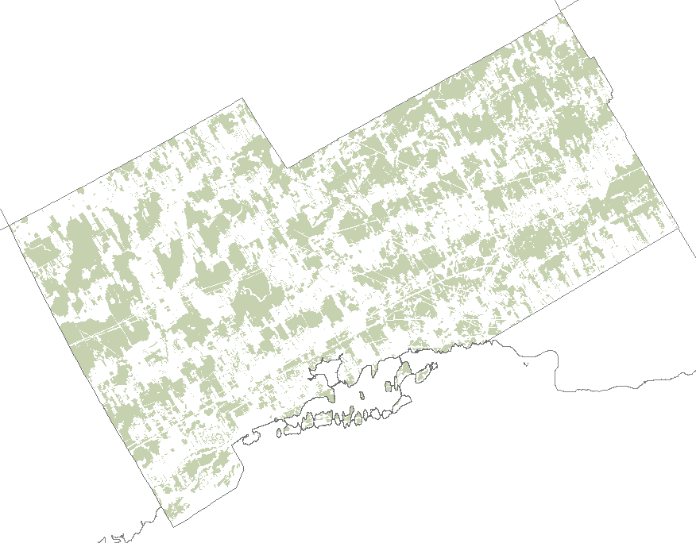
2008 Forest Cover Analysis
28.1% at a watershed level
42% total
38.5% natural
2% plantation
1.5% hedgerow
Joel Martineau, Forestry Technician
Notes:
Environment Canada released a report titled ‘ How much habitat is enough’. An absolute minimum of 30% forest cover is essential for a healthy and sustainable ecosystem. Loss of forest cover in Ontario is contributing to an unstable ecosystem, habitat loss, and environmental degradation.

Slide 4
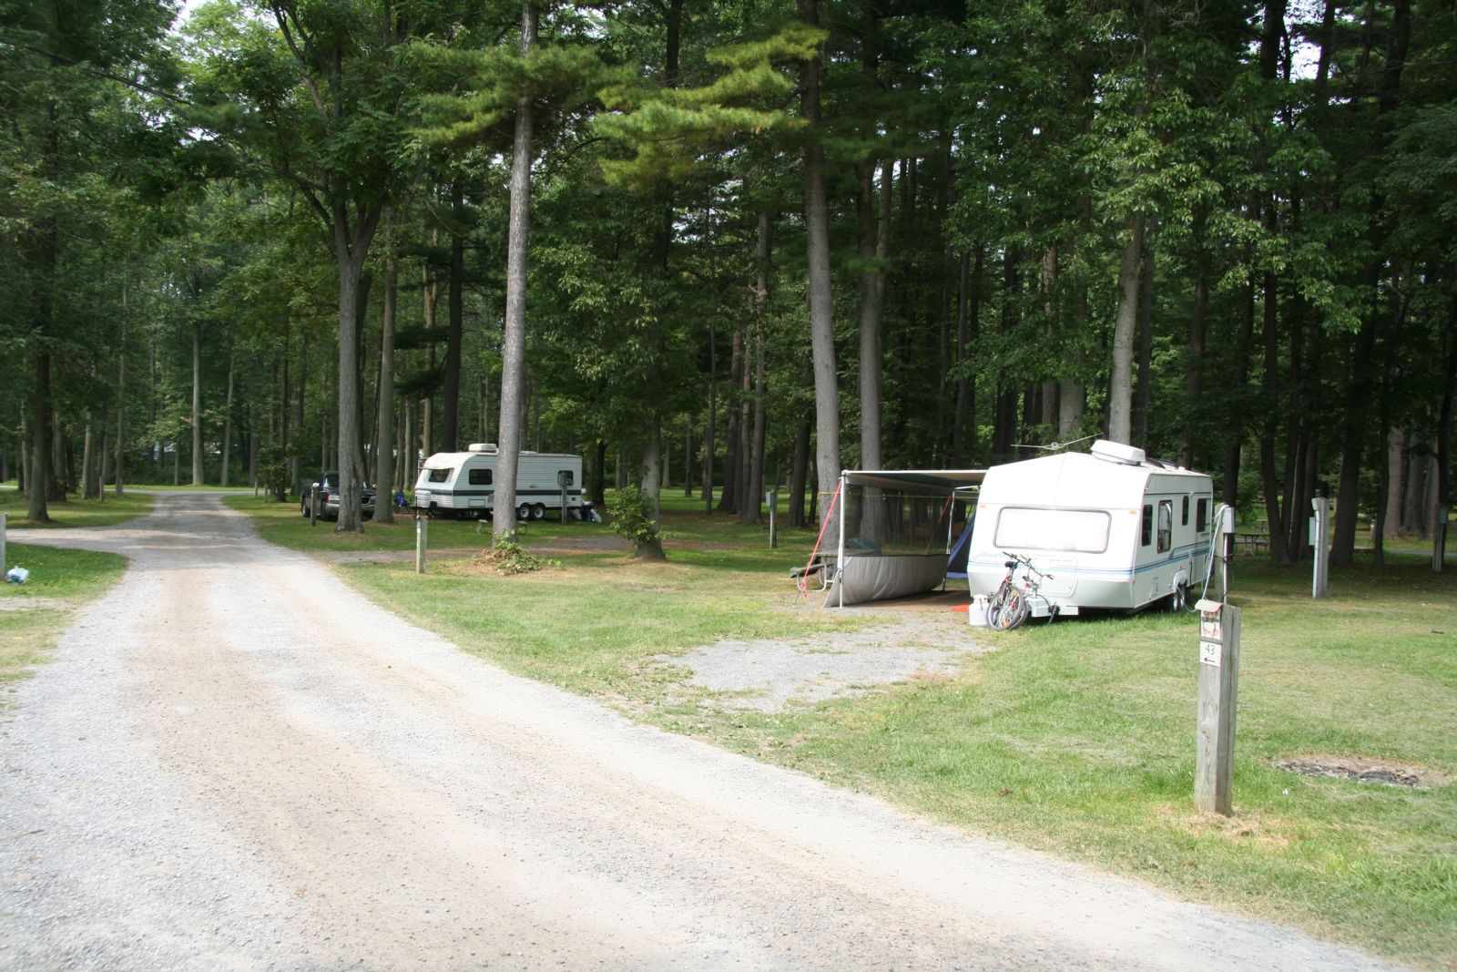
SLPC Tree Risk Evaluations
Tree risk assessments and digital data collection
8 parks
Thousands of Trees
Joel Martineau, Forestry Technician

Slide 5
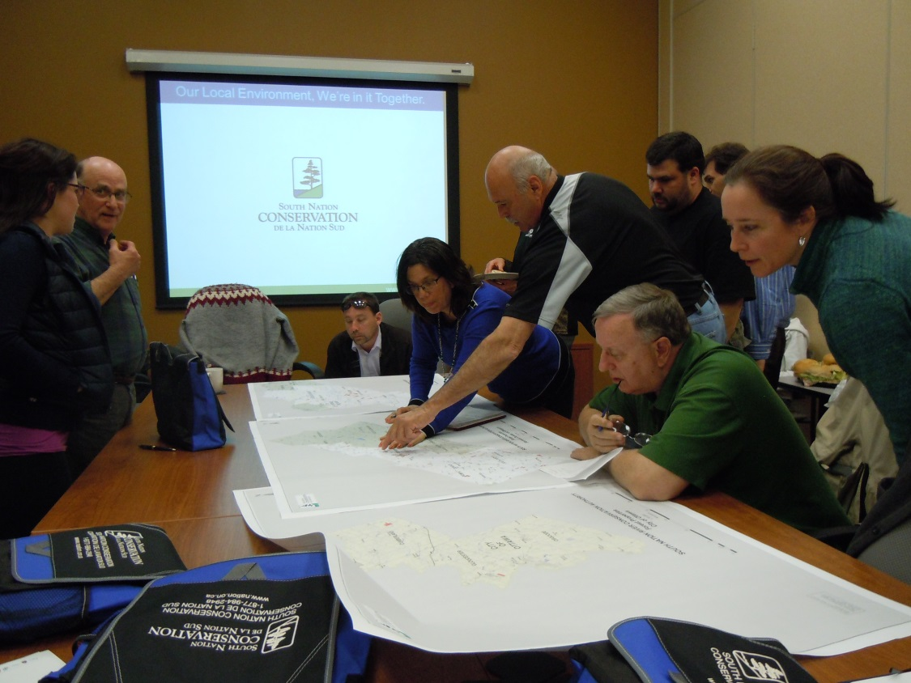
Forest Stewards Program
Tasks include observations, reporting issues for resolution, limited trail maintenance and species identification
New recruits are always welcome
Forest Stewards training session at South Nation office – 2015
Joel Martineau, Forestry Technician
Notes:
Volunteers receive training to assist SNC in the proper management of its forests, monitoring assigned properties in the vicinity of where they live and reporting deficiencies and requirements. New recruits are always welcome, with no previous experience needed.
Tasks include SNC property use observations, reporting issues for resolution, limited trail maintenance, species identification to help develop a comprehensive list, participation in planning and leading local educational activities, photo documentation, record keeping and submission, and representing SNC at public events.
Forest stewards reflect a broad range, from hunters and naturalists, to watershed residents with a general interest in protecting area forests. And the job isn’t restricted by gender or age, other than applicants must be at least 18 years old.
“We’re looking for eyes and ears on the ground,” Brizard said, “people on the lookout for blocked trails, hazards and signs of activities we don’t permit.”
“It’s a great way to get involved and help preserve the beauty and accessibility of the natural spaces maintained by South Nation for public use and enjoyment.”

Slide 6
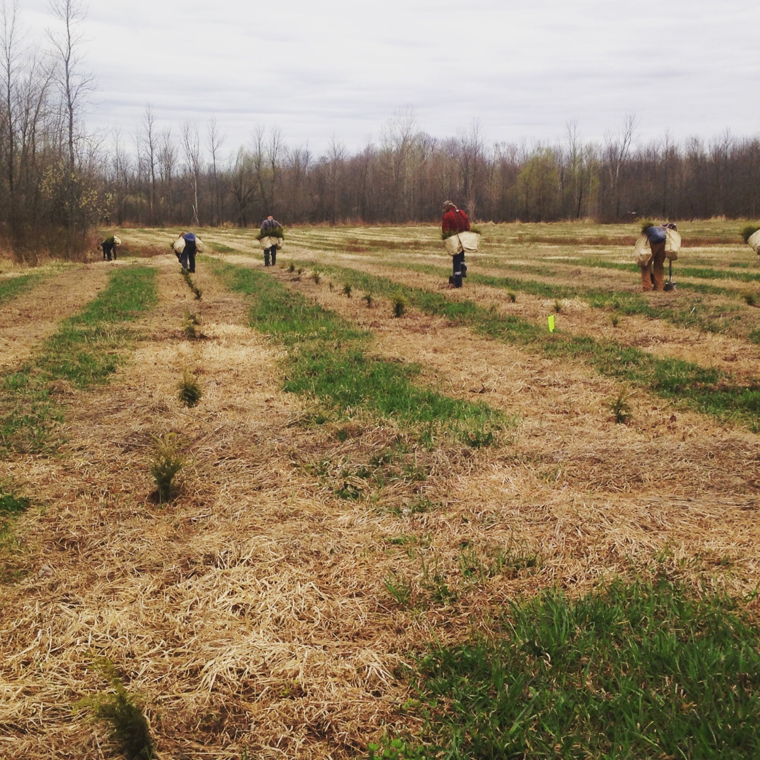
50 Million Tree Program
Free site visit
Minimum site size of 1 hectare (2.5 acres)
1500 trees for windbreaks, 2000 trees for plantations
$0.20/conifers and $0.50 for deciduous
Tree Planters planting in Spring, 2015
Joel Martineau, Forestry Technician
Notes:
Program is designed to increase the number of trees being planted by reducing the cost to the landowner.
Program aims to increase forest interior, bugger watercourses and wetland areas. Protect Fragile Lands, protect identified high value conservation areas and establish corridors between isolated natural areas.

Slide 7
Survival Assessments
Assessments in years 1, 2 and 5
60% survival and higher
Tamarack after first growing season
Joel Martineau, Forestry Technician

Slide 8
Woodlot Advisory Service (WAS)
Free year round site visits
Must own at least 4 hectares (9.88 acres) of woodland
Must reside in SNC jurisdiction
Promote sustainable management of privately owned woodlot
WAS Site visit 2014
Joel Martineau, Forestry Technician
Notes:
Bilingual Service
Property Maps and Forestry Resources
Workshops provided through the WAS partners throughout the year

Slide 9
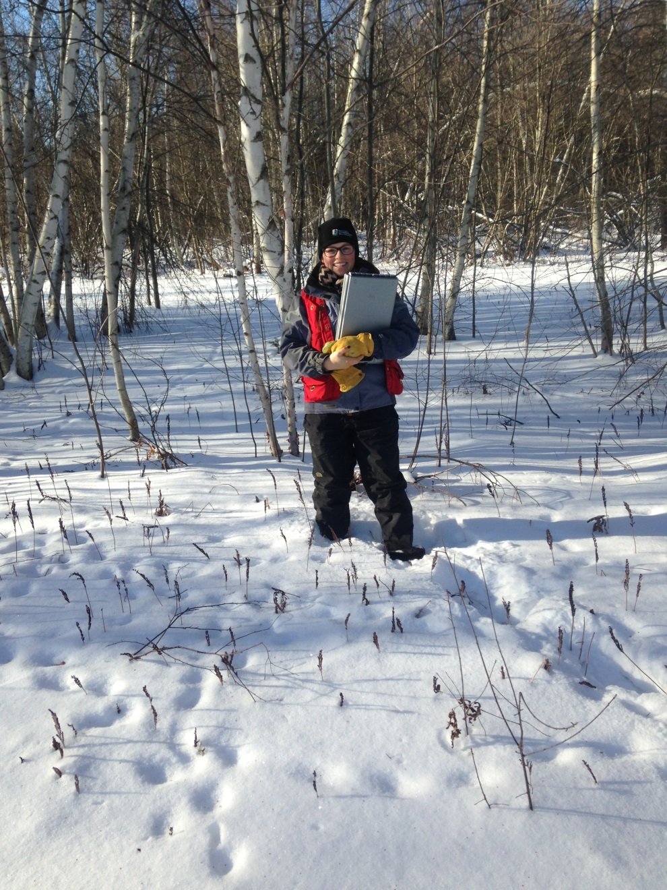
Managed Forest Plan (MFTIP)
Grant available in the amount of up to $500 for the completion of a management plan
Sponsored by OPG, Ontario Woodlot Association, UCPR
Up to 75% tax savings on woodlots
Joel Martineau, Forestry Technician

Slide 10
Program Uptake
Woodlot Advisory Service (No. of Landowners Visited)
2011 | 2012 | 2013 | 2014
5 | 4 | - | -
No. of Trees Planted
2011 | 2012 | 2013 | 2014 | 2015
- | 9900 | - | 4710 | 3350
Joel Martineau, Forestry Technician

Slide 11
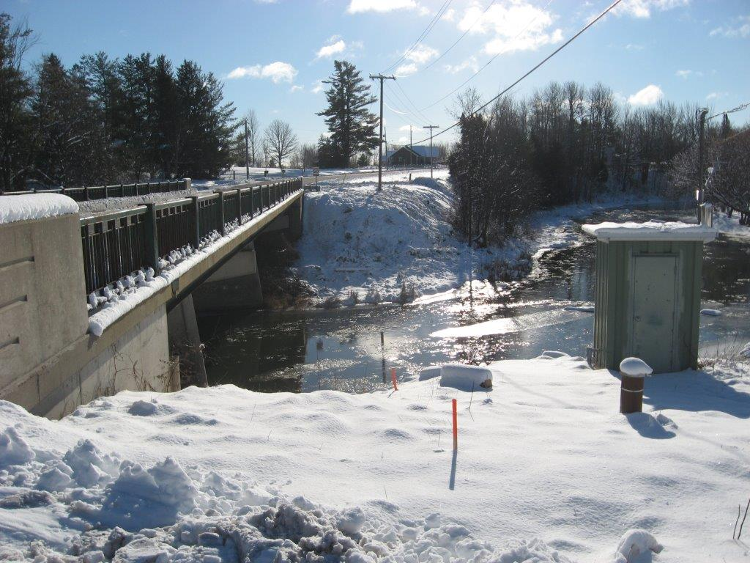
Science in Action: Water Monitoring
Understanding our watershed resources
Surface water quantity:
10 stream gauges
17 ice survey stations
7 snow stations
11 rain gauges
2 meteorological stations
Dataloggers – strategically located
Climate Station – Wade Rd. Russell
Golam Sharif, Water Resources Analyst

Slide 12
Science in Action: Water Monitoring
Understanding our watershed resources
Surface water quality:
- 13 stations.
Groundwater quantity/quality:
- 17 wells
Water quality monitoring - Embrun
Golam Sharif, Water Resources Analyst

Slide 13
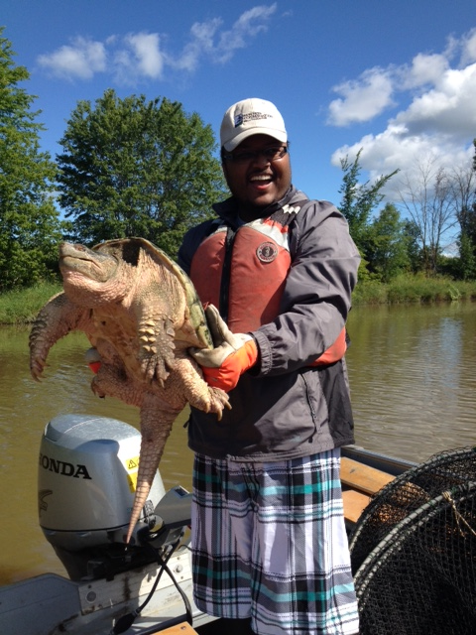
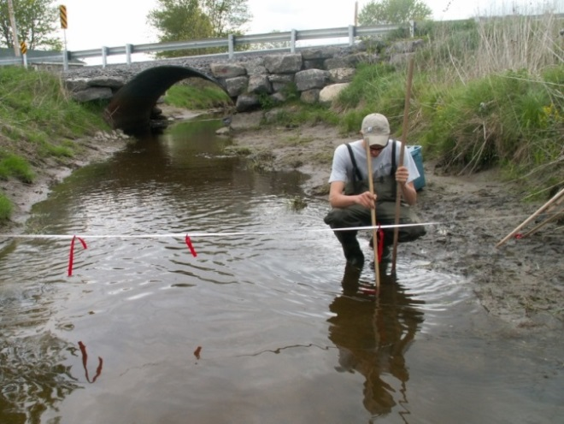
Science in Action: Fish and Wildlife
Assessing our fish and wildlife
Stream Assessments (25)
Fish populations (20)
Species at Risk: eels, turtles, birds, plants
Invasive Alien Species: Chinese Mystery Snails, Dog Strangling Vine
Golam Sharif, Water Resources Analyst

Slide 14
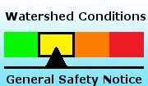
Science in Action: Watershed Conditions
Developing tools to protect our residents and their property
Floods and Droughts forecast – 365 days
Municipal Emergency Management Committees – 15 meetings
Adapting to extreme weather events - NEW
Golam Sharif, Water Resources Analyst

Slide 15
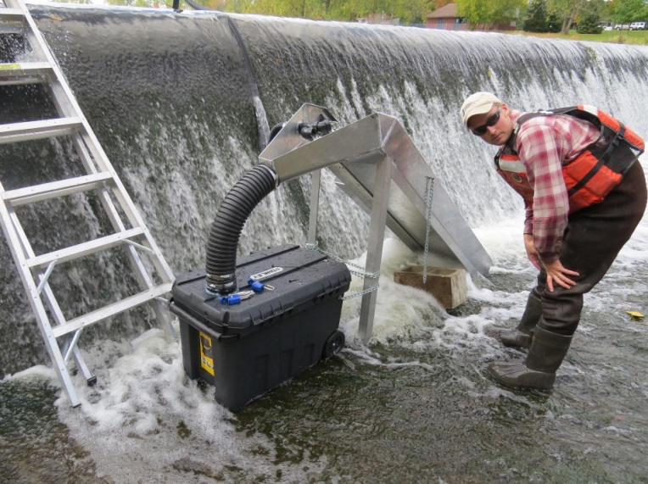
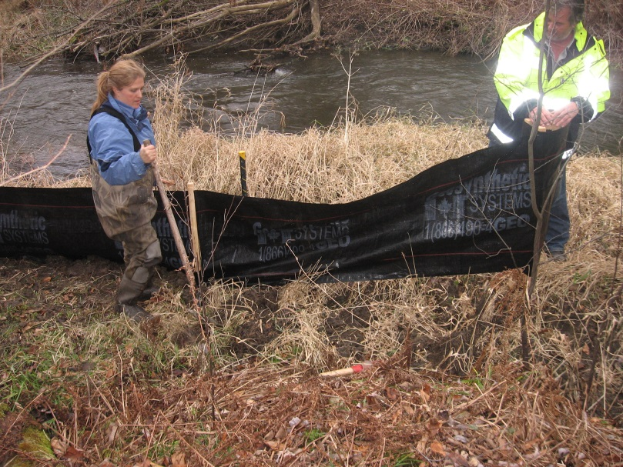
Science in Action: Projects
Implementing on the ground solutions
Eels and turtles habitat enhancement projects
Kirby Creek restoration of habitat (57.5 km2)
Parlow Creek restoration of flows and habitat creation (600 m)
Shields Creek Rehabilitation Project
Eel ladder – Russell Weir
Erosion repair – Moose Creek
Golam Sharif, Water Resources Analyst

Slide 16
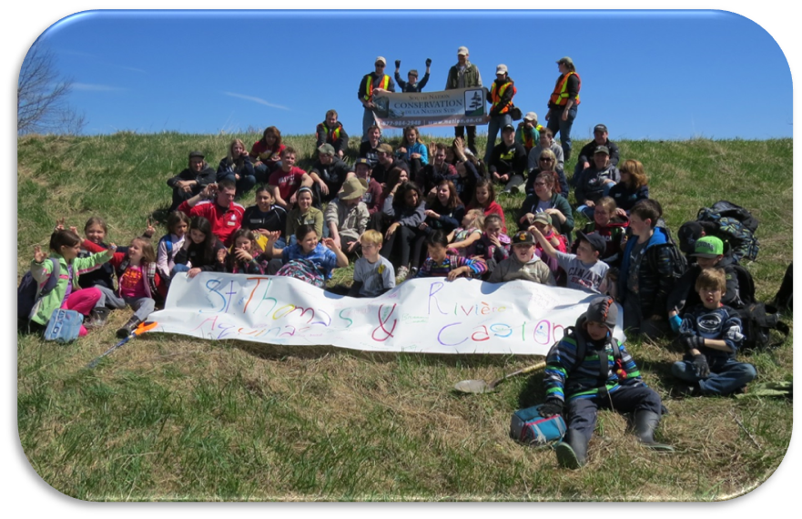
Science in Action: Volunteering
Empowering volunteers to action
Stream Watch Program
Collect information on physical and biological characteristics of the stream
Encourages community involvement to conduct stream assessments and volunteer events
Tree Planting- Embrun, May 2014. Stream Watch Program
Golam Sharif, Water Resources Analyst

Slide 17
Clean Water Grants
SNC Clean water Program; Ottawa Rural Clean Water Program – 80 grants
Landowner cost-share grants and Peer-to-Peer delivery through Program Reps
Projects include:
Buffer strips
Livestock restrictions
Stream bank stabilization
Well decommissioning
Nutrient Management Plans
Mario and Theo Nyentap ,
Dairy Farmers in City of Ottawa, 2014 Precision Farming Project
Golam Sharif, Water Resources Analyst

Slide 18
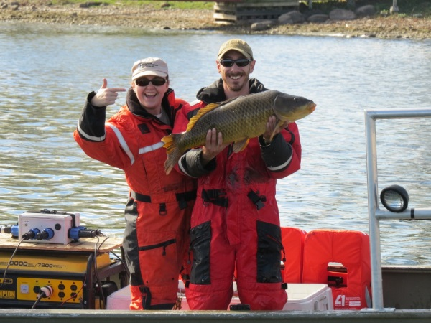
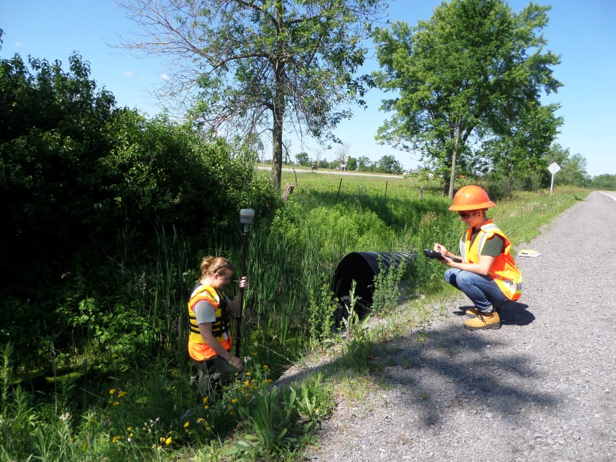
Science in Action: Projects
Providing cost-effective expertise
Port of Johnstown – 2 compensation projects
Preparing Flood Plain Mapping – in partnership with the City
Research Partnerships: Watershed Evaluation of Beneficial Management Practices and Agricultural Greenhouse Gases
Golam Sharif, Water Resources Analyst

