Slide 1
Clean Water
Committee Update
June 10, 2019

Slide 2
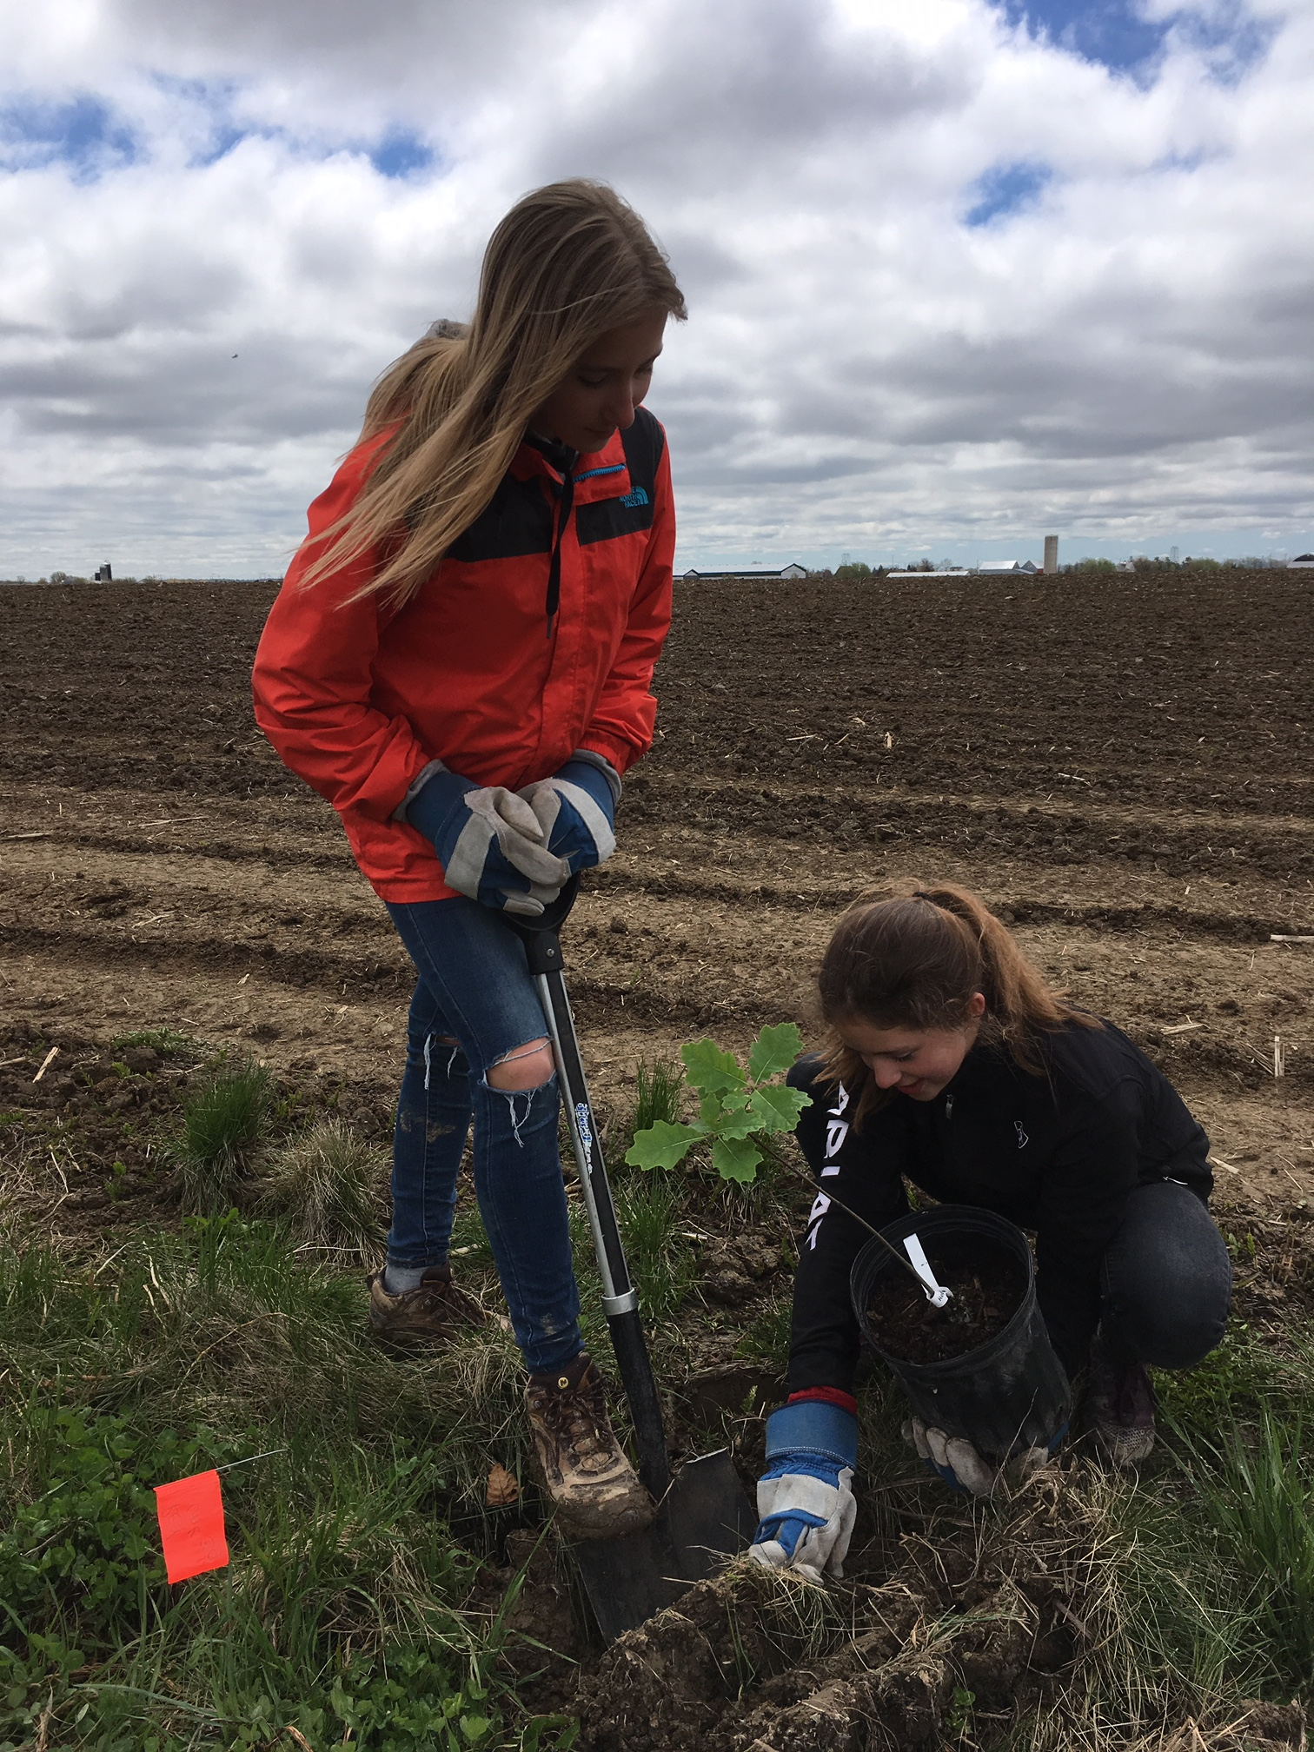
Eco Action Buffer Demonstration Projects
4 farms: St. Isidore, Casselman, Navan, Brinston
Edible buffer on one side of municipal drain, grass buff on other
High School SHSM partnerships
First Nations Education
GDHS students at Bercier's Farm in St. Isidore,
May 16th, 2019

Slide 3
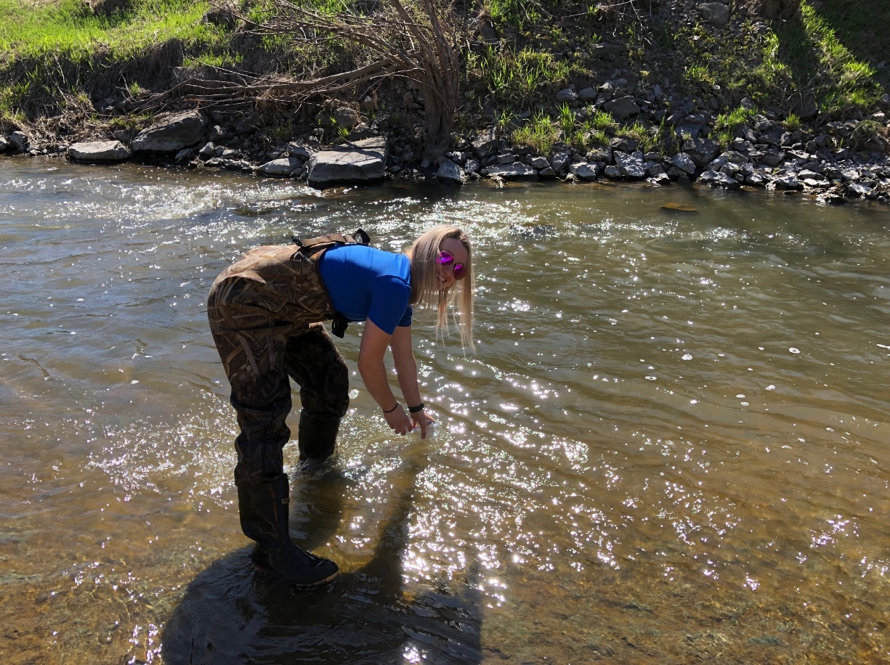
City of Ottawa Baseline Program
Working with City of Ottawa and Laboratory
12 Stations monitored monthy
Nutrients, Metals and Gen Chem
Biological Monitoring
Capture in SNC Wiski Platform

Slide 4
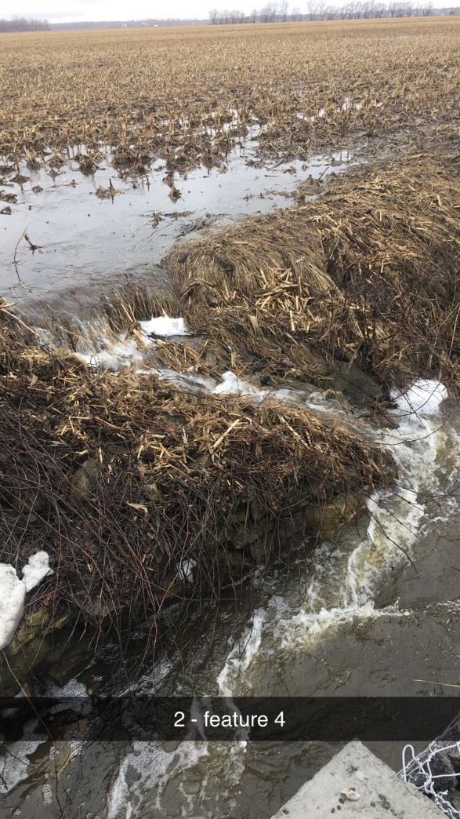
North Castor Catchment Study
30 HDF Stations
4 Baseline WQ Stations
2 YSI Sonde Deployments
Temperature and Baseflow
Biological Monitoring
HDF Station in North Castor, April 2019

Slide 6
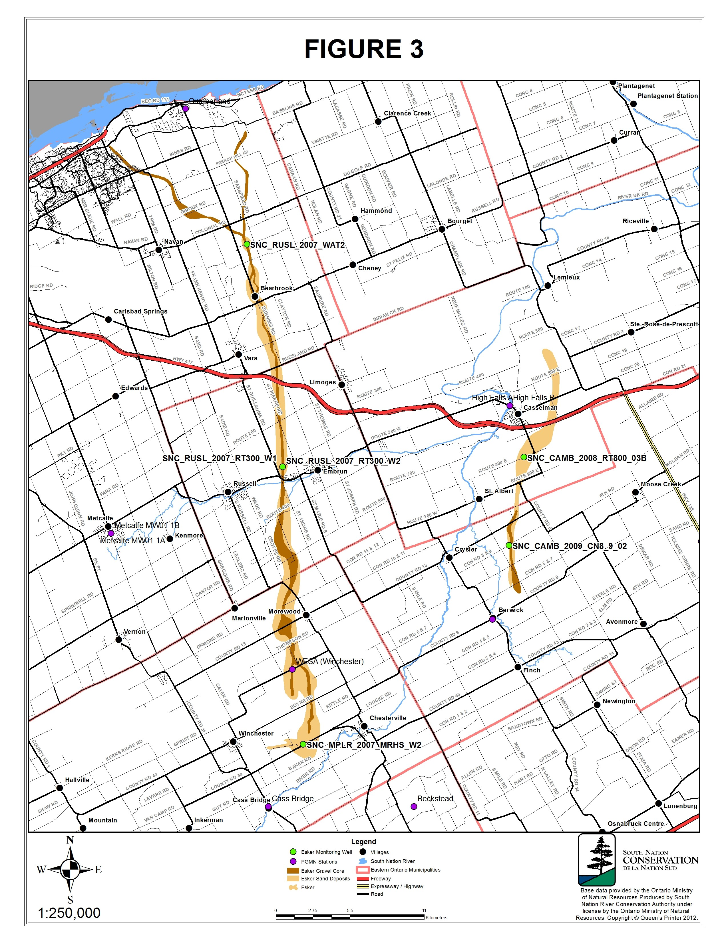
Vars-Winchester Esker Data Collection Platform

Slide 7
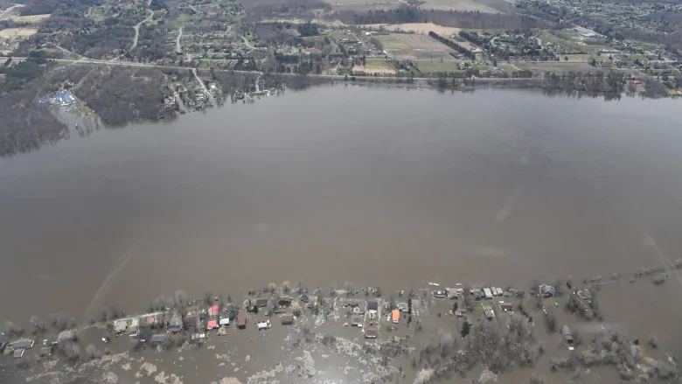
Precipitation Trends in Ontario
Frequency and severity of storms increasing
Precipitation is one of the hardest parameters to measure
Need continuous, long-term data sets with good coverage
Ottawa River near Cumberland, ON, May 2019

Slide 8
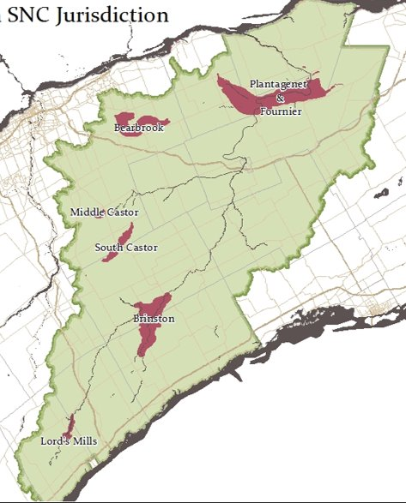
Flood Prone Areas in the SNC Jurisdiction

Slide 9
Watson Pit Esker Well North of Vars, ON
Watson Pit Vars-Winchester Esker Well Water Levels

Slide 10
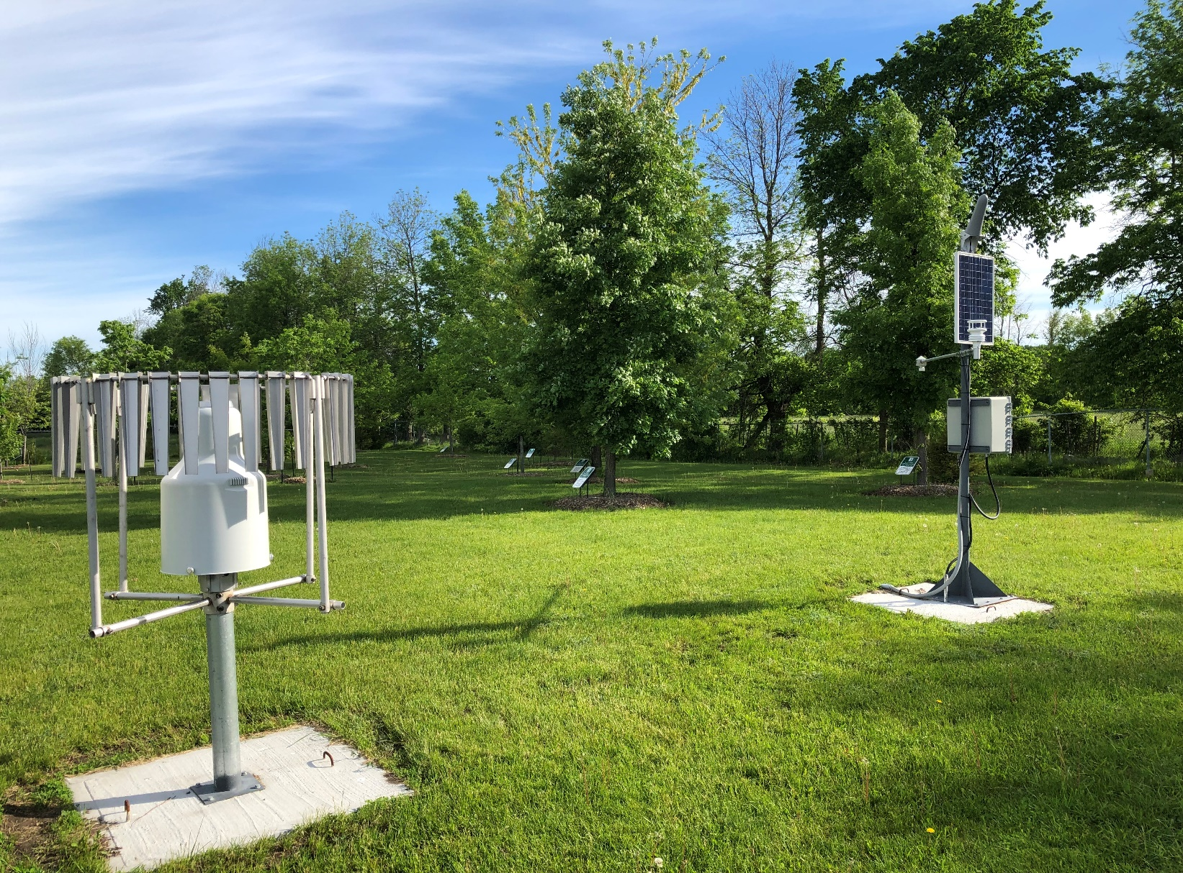
Data Collection Platform

Slide 11
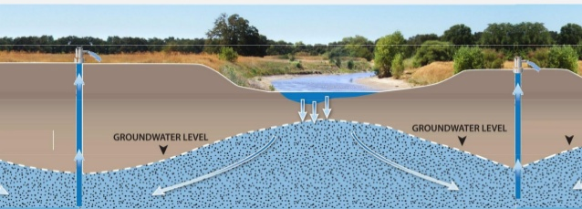
Groundwater Surface Water Constraint Mapping

Slide 12
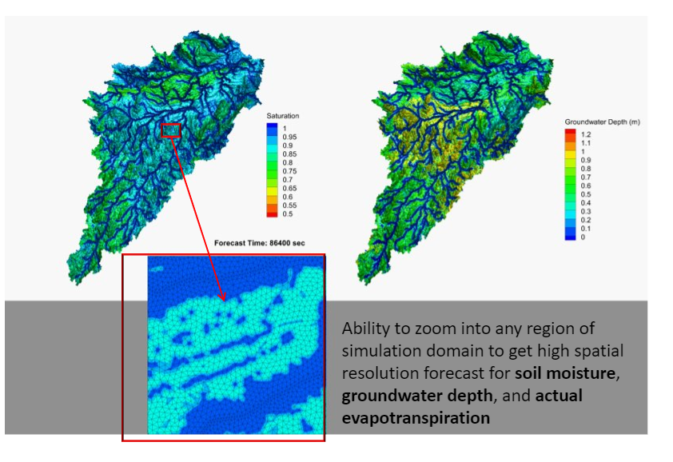
HydroGeosphere Model

Slide 13
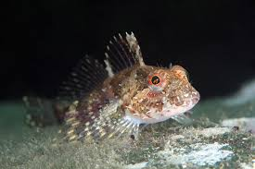
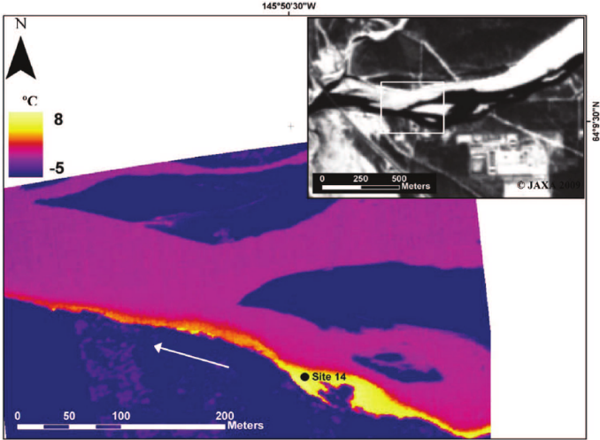
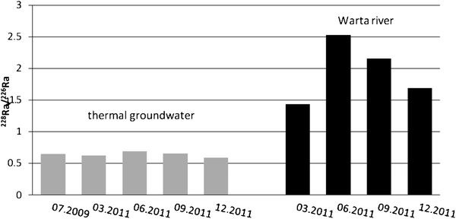
Field Validation of Desktop Exercise

