Slide 1
Project Update
Communications Committee
July 11, 2018

Slide 2
Communications and Outreach Team
John Mesman, Team Lead, Communications and Outreach
Kelsey Smith, Communications and Outreach Assistant
Karen Paquette, Fisheries Technician
Department Updates:
Taylor Campbell, Communications Specialist
Samantha DeVries, Communications and Outreach Assistant
Meagan Casalino, Communications and Outreach Assistant
Cindy Saucier, Education Steward
John Mesman, Team Lead, Communications and Outreach

Slide 3
Cache In Trash Out
Saturday, April 28 in Clarence-Rockland
Annual community clean up and geocaching event
Approximately 80 people took part
Kelsey Smith, Communications and Outreach Assistant

Slide 4
Findlay Creek Tree Giveaway
Saturday, April 28 at Diamond Jubilee Park in Findlay Creek (Ottawa)
100 trees and shrubs provided to residents, sponsored by the land developers
Karen Paquette, Fisheries Technician

Slide 5
Moose Creek Tree Giveaway
Saturday, May 12 at Moose Creek Community Centre
100 trees and shrubs provided to residents, sponsored by GFL Environmental
Karen Paquette, Fisheries Technician

Slide 6
3 Millionth Tree Planting
Saturday, May 5 at Camp Sheldrick in North Dundas
Video: https://www.youtube.com/watch?v=1c-lZ6VtQDM
John Mesman, Team Lead, Communications and Outreach

Slide 7
MacIntosh Park Family Day
Sunday, May 27 at MacIntosh Park in North Stormont
Taylor Campbell, Communications Specialist

Slide 8
Memorial Tree Planting – McIntosh Park
SNC hosted the British Home Children AGM at the SNC Office and hosted a memorial tree planting at McIntosh Park
All of the trees and benches in the McIntosh Park are donated through the Tree Dedication Program
Tree donation cost is $300
Taylor Campbell, Communications Specialist

Slide 9
Spencerville Mill Canoe Poker Run
Saturday, May 26 in Edwardsburgh/Cardinal
Video: https://www.facebook.com/SouthNationConservation/videos/10156508268850439/
Meagan Casalino, Communications and Outreach Assistant

Slide 10
Chesterville Kayak Club Poker Run
Saturday, June 9 at Cass Bridge in North Dundas
Video: https://www.facebook.com/SouthNationConservation/videos/10156594323605439/
Meagan Casalino, Communications and Outreach Assistant

Slide 11
Alvin Runnalls Forest Unveiling
Sunday, June 10 in North Dundas
SNC and SDG owned forest, opened as part of SDG’s new forest naming initiative, which has named 7 County Forests
70 attendees
Kelsey Smith, Communications and Outreach Assistant

Slide 12
Stream of Dreams
SNC has completed its 4th Stream of Dreams school program and mural
June 13 & 14 at Mother Teresa Catholic School in Russell
Over 400 students participated and painted a fish
Funding received through the Great Lakes Guardian Community Fund
Karen Paquette, Fisheries Technician

Slide 13
Burr Oak Tree Planting in Russell
Thursday, June 28 at the Russell Library
3 trees donated by SNC to the top 3 Russell Parade winners from the 2017 Canada 150 celebration; trees planted at library, sports dome and museum
Karen Paquette, Fisheries Technician

Slide 14
Ian Mitchell Bench Dedication
Saturday, July 7 at Reveler Conservation Area in North Stormont
Benches dedicated through the Ian Mitchell Memorial Fund, honoring a true “Friend of SNC”
John Mesman, Team Lead, Communications and Outreach

Slide 15
Youth Fishing Day Camp – Camp #1
July 4 & 5 at High Falls Conservation Area in Casselman
15 kids registered each day (full capacity)
Samantha DeVries, Communications and Outreach Assistant

Slide 16
It’s All About the River Fishing Tournament
Saturday, July 21 at Morrisburg Waterfront Park
11 am – 4 pm
BBQ, free fishing, live music, local vendors, family activities and prizes
New event: St. Lawrence River
John Mesman, Team Lead, Communications and Outreach

Slide 17
Geopassport Launch
Saturday, July 21 at 1 pm, at Oschmann Forest in North Dundas
Unveiling of Geopassport and Maple Education Program
John Mesman, Team Lead, Communications and Outreach

Slide 18
Friends of SNC Golf Tournament
Thursday, August 9 at Nation Golf Club in Alfred-Plantagenet
8:00 am breakfast,
9:30 am start time
Kelsey Smith, Communications and Outreach Assistant

Slide 19
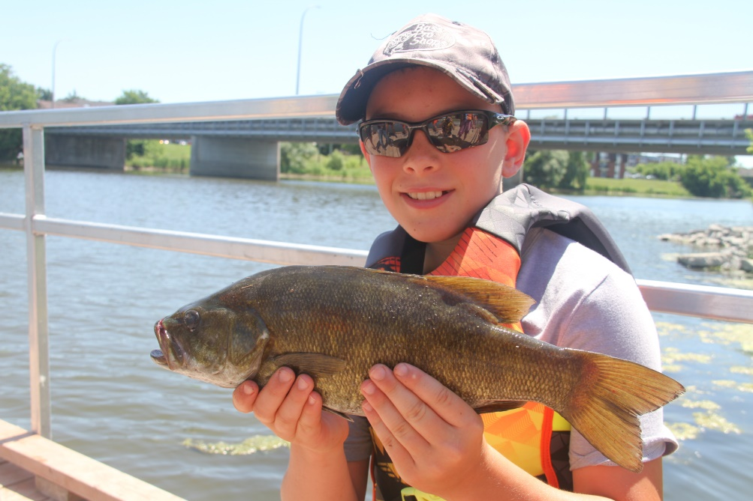
Upcoming Events
EscarpAction Jessup’s Falls Festival – July 15
Youth Fishing Day Camp # 2 – July 18 & 19
MS Bike Tour – August 18 & 19
Kelsey Smith, Communications and Outreach Assistant

Slide 20
Social Media: Facebook Stats
4.6% increase in “Likes” since last committee meeting in April
Taylor Campbell, Communications Specialist

Slide 21
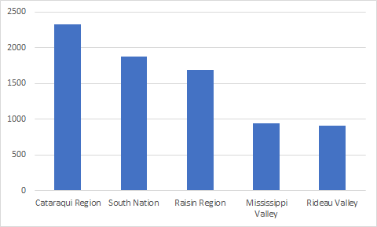
Social Media: Facebook Stats
Comparison between local CA partner Facebook Pages
Taylor Campbell, Communications Specialist

Slide 22
Social Media: Facebook Post Examples
Chesterville Kayak Club Poker Run
3,776 people reached
1,515 views
20 reactions
Taylor Campbell, Communications Specialist

Slide 23
Social Media: Facebook Post Examples
3 Millionth Tree
13,049 people reached
7630 video views
208 reactions, comments, shares
John Mesman, Team Lead, Communications and Outreach

Slide 24
Social Media: Facebook Post Examples
Tree Planting in Russell
1,456 people reached
74 reactions, comments, shares
204 post clicks
Taylor Campbell, Communications Specialist

