Slide 1
Clean Water Committee Meeting Thursday March 1st, 2018 9: 30 am

Slide 2
Ottawa Rural Clean Water Grant Program

Slide 3
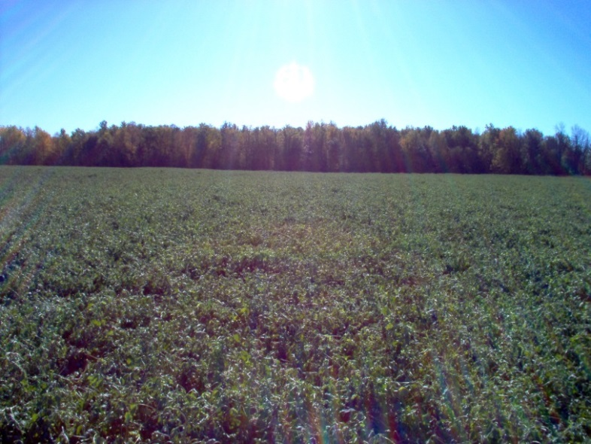
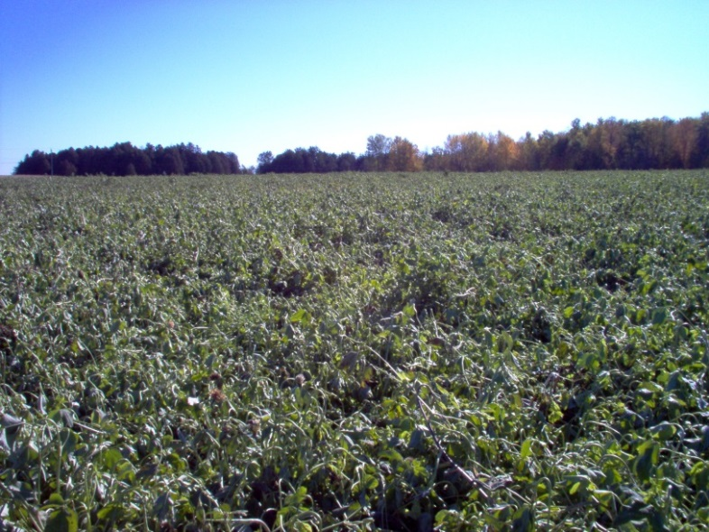
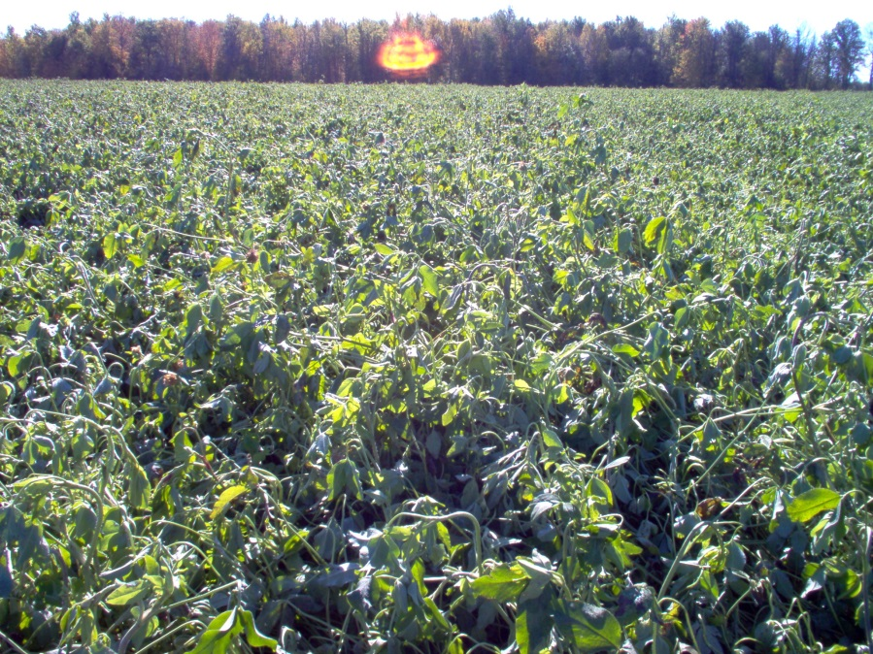
05 16 2102 DDB Pg. Agenda

Slide 4
05 16 2102 DDB Pg. Agenda

Slide 5
Clean Water Grant Program

Slide 6
2017-NAT-CW27 Pg. Agenda
NO PHOTO AVAILABLE

Slide 7
2017-NAT-CW27 Pg. 26 Agenda

Slide 8
2017-NAT-CW27 Pg. Agenda

